Slide 1
Newton’s Law of Universal Gravitation

Slide 2

Newton recognized that two objects with mass will attract each other:
r
m₂
m₁
• The force of attraction depends on the masses of the objects and the distance (radius) between them
increases
→ If the masses increase then the force ____________
F α m₁m₂
decreases
→ If the radius increases then the force ____________

Slide 3
Gravity is Proportional to Mass
Assume that the force of gravity between two objects is 100N.
What is the new force if the mass of object #1 is doubled?
What is the new force if the mass of object #2 is reduced by half (divided by two)?
F α m₁m₂

Slide 4
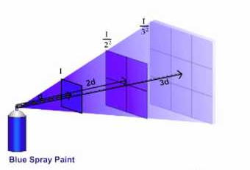
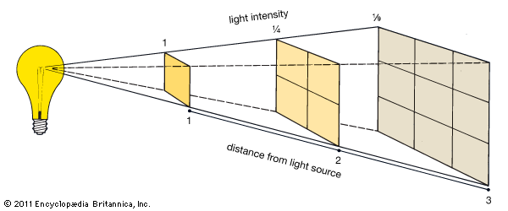
Inverse Square Law
The effect of many relationships in Physics decrease in intensity according to the "Inverse Square Law"

Slide 5
Gravity is Inversely Proportional to Distance
Assume that the force of gravity between two objects is 100N.
What is the new force if the distance between the objects is doubled?
What is the new force if the distance between the objects is reduced by half (divided by two)?

Slide 6
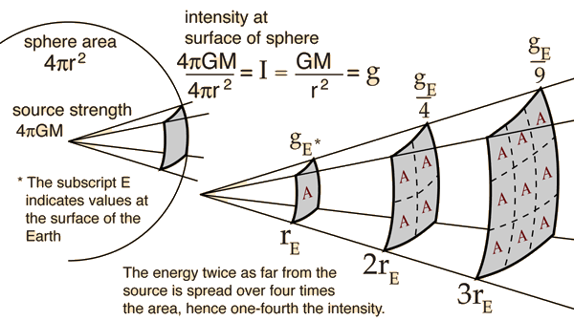
Inverse Square Law
Gravity follows the "Inverse Square Law"

Slide 7

Newton’s Law of Universal Gravitation
Where: m₁ and m₂ are mass in kg
r is the distance between the objects in meters
G is the Universal Gravitational Constant:
G = 6.67 x 10⁻¹¹ Nm²/kg²

Slide 8


Example 1:
Two students, of mass 64 kg and 72 kg are sitting so that they are separated by a distance of 2.8 m. Find the magnitude of the gravitational force between them.
m₁=64 kg
m₁=72 kg
r=2.8 m
G=6.67 x 10⁻¹¹ Nm²/kg²
Ans: 3.9 x 10 ⁻⁸ N

Slide 9


Example 2a:
A cat of mass 5Kg is sitting on the surface of the Earth. Use F_{g} = mg to find the force of gravity on the cat.
Example 2b:
Use Newton’s Law of Universal Gravitation to find the force of gravity on the same cat. Assume the following values for the mass and radius of Earth.
Mass of Earth: 5.97 x 10²⁴ kg Radius of Earth= 6.37 x 10 ⁶ m
r_{Earth}

Slide 10

We can use both expressions for gravitational force to find the force of gravity on an object (a cat for example) on the surface of the Earth:
Cat mass= m
Earth mass = M_{Earth}
Radius between cat and Earth= r_{Earth}
r_{Earth}
But both of these expressions must be the SAME!!
F_{g} = F_{G}

Slide 11


The mass of the object cancels!!
So this gives us an expression for calculating the gravitational field strength of the Earth !!!!
Example: M_{E}= 5.97 x 10²⁴ kg, r_{E} = 6.37 x 10⁶ m
Calculate the value of g for the Earth.

Slide 12
Example 3a:
What is the gravitational force on a 520 kg rocket which is in orbit at a distance of 7.37 x 10 ⁶ m from the centre of the Earth?
Mass of Earth: 5.97 x 10²⁴ kg Radius of Earth= 6.37 x 10 ⁶ m
Example 3b:
What is the gravitational force on a 520 kg rocket which is in orbit at a distance of 1.00 x 10 ⁶ m above the surface of the Earth?
Mass of Earth: 5.97 x 10²⁴ kg Radius of Earth= 6.37 x 10 ⁶ m
h
R_{Earth}
Ans: 3.81 x 10³ N

Slide 14
Classwork:
Read Section 4.2 pages109-113
Read Section 4.3 pages115-118
Complete Worksheet

